Slide 1

Challenge Introduction
Notes:
Teacher info, do not show to students:
Organisation sign up is needed before students can sign up. Organisation sign up can be completed here:
[space for the link]
Resources, teacher pack and more can be found online here: ​
[space for the link]
If you want to add additional requirements like people must be from certain form classes/year groups/must tell a teacher please edit the slides as appropriate. The competition brief must not change though.

Slide 2

What is in these slides
What is HopefulFuturesAI
How to register for the challenge​
How to submit your entry​
What will happen if you are selected to be exhibited

Slide 3
What is Hopeful futures AI?
A challenge to imagine a world with a happier, healthier future enabled by AI. ​
This challenge will be run nationwide, with secondary school students (KS3/4) and youth organisations. It will open in December 2025 and close on Friday 27th February 2026 at 4pm ​
There will be several judging categories, and judging outcomes will be released March 2026 . ​

Slide 4


Slide 5
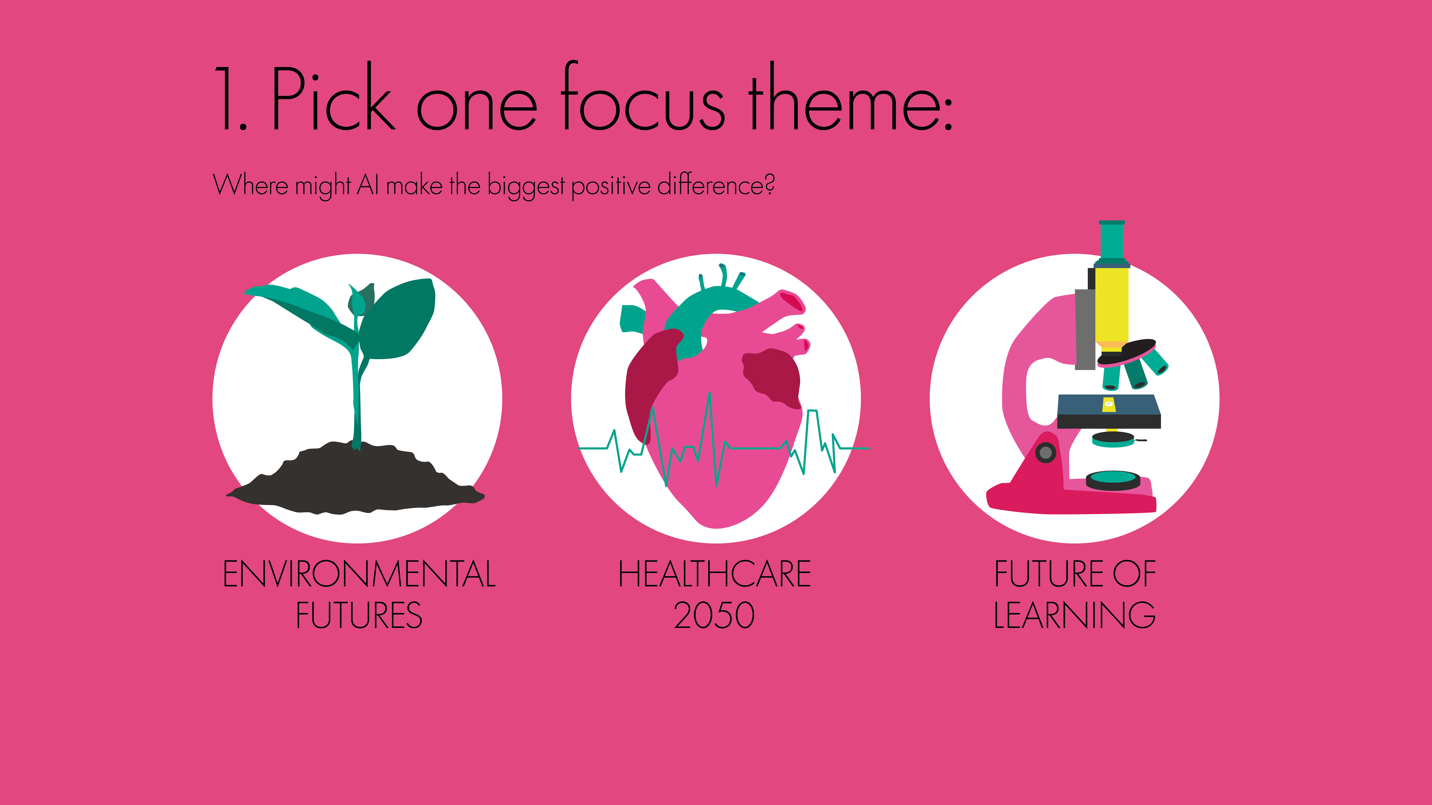

Slide 6
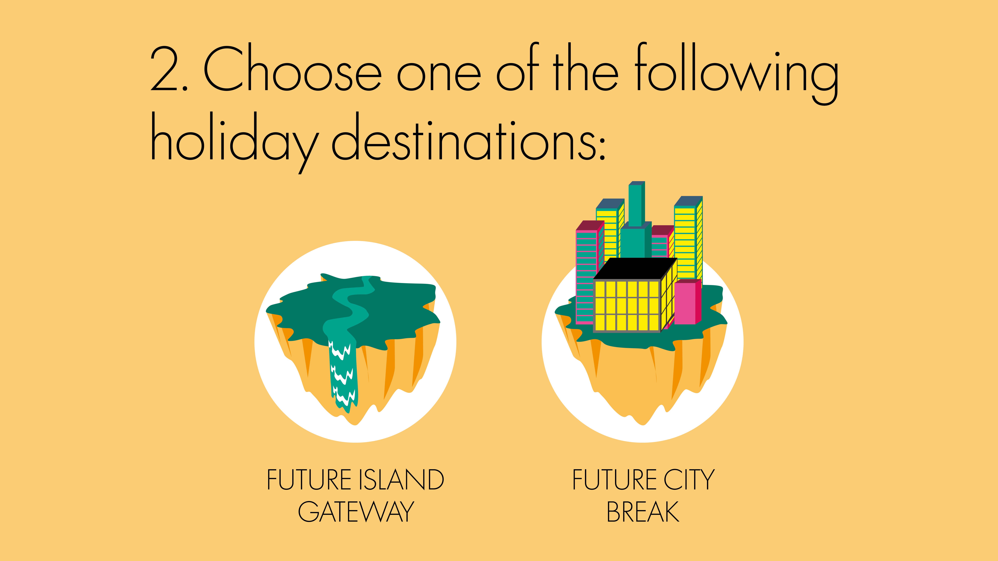

Slide 7
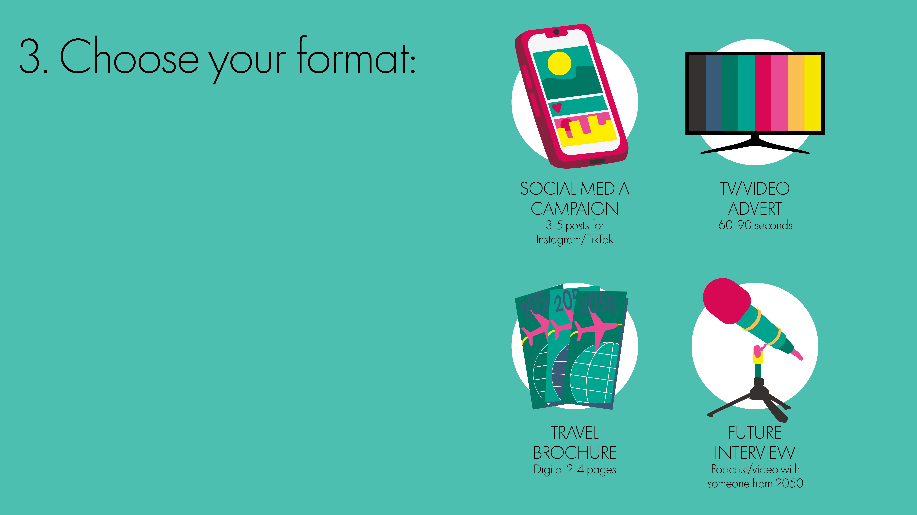

Slide 8
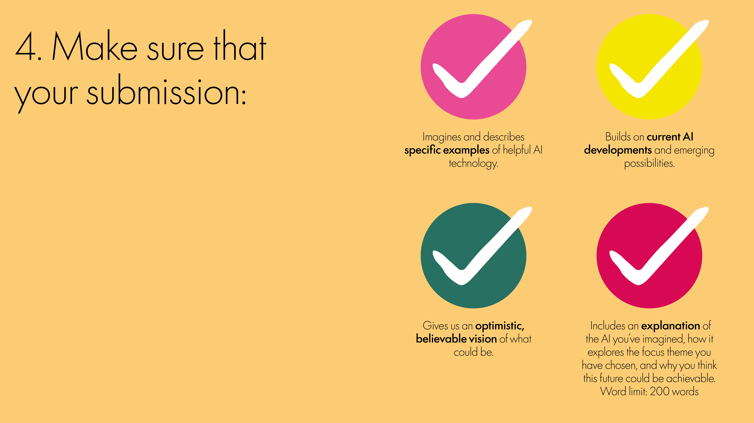

Slide 9
How do I enter?
Your team can enter the competition via our challenge website:
https://hopefulfutures.ai/
Individual young people may also submit an entry – please visit the website for more information

Slide 10
What will happen if I am a winner?
This is not a competition so there are no winners, no first, secondhand or third. But there are some additional judging criteria that can gain you extra awards, they are as follows:
A certificate from the HopefulFuturesAI team for taking part
An exhibition certificate from the judging panel if your team’s work is selected for display.
The panel will also send your team a letter of commendation if they think your work has achieved something extra – for example, it has been extra successful at explaining a new AI technology, or it has been really good at addressing your chosen focus theme.

